Slide 1

AIRBNB HOTEL BOOKING ANALYSIS
DIVYA SHARMA
INTERNSHIP_17546440516895be537820f

Slide 2

PROBLEM STATEMENT
The short-term rental market in cities is highly dynamic, with thousands of Airbnb listings varying in price, location, room type, and availability. Hosts struggle to set competitive prices and manage bookings, while guests face difficulty in finding suitable, affordable, and well-reviewed accommodations. Additionally, extreme pricing, irregular availability, and inconsistent reviews make it challenging to understand market trends and make data-driven decisions. So, pricing an Airbnb property correctly is crucial for both hosts and travelers.

Slide 3
Project Description
This project analyzes the Airbnb Open Dataset to extract actionable insights into the short-term rental market. The analysis includes:
Data cleaning (handling missing values, removing duplicates, converting price & dates).
Exploratory Data Analysis (EDA) to study neighbourhood trends, room types, availability, and pricing.
Visualization of patterns in host activity, guest reviews, and geographical distribution of listings.
A predictive model (Random Forest Regressor) for estimating Airbnb listing prices.

Slide 4

WHO ARE THE END USERS?
Airbnb Hosts → to set competitive prices and improve listing performance.
Guests → to identify affordable, high-quality accommodation.
Airbnb Analysts→ to understand NYC market trends and improve platform strategy.
Researchers & Analysts → to study urban tourism trends, pricing models, and sharing economy dynamics.
Students & Learners → to practice data analysis, machine learning, and visualization skills using real-world datasets.

Slide 5

Technology Used
Python Libraries:
Pandas → Data manipulation, cleaning, and aggregation.
NumPy → Numerical computations, arrays, and mathematical operations.
Matplotlib & Seaborn → Data visualization, plotting charts, heatmaps, and graphs.
Scikit-learn → Machine learning algorithms, model building, and evaluation.
Modeling:
Random Forest Regressor → Predict Airbnb listing prices based on numeric and categorical features.
Tools & Platforms:
Google Colab → Interactive Python coding, visualization, and experimentation.
GitHub → Version control and sharing project code with collaborators.

Slide 6
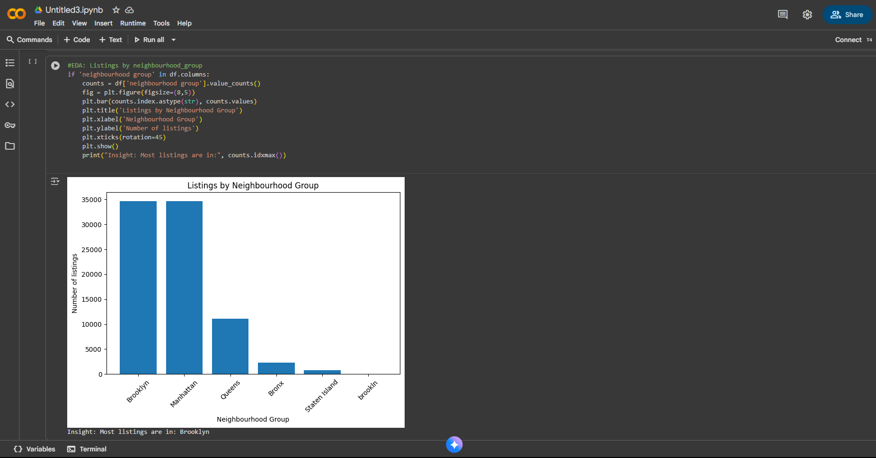
RESULTS1
Demo Link

Slide 7
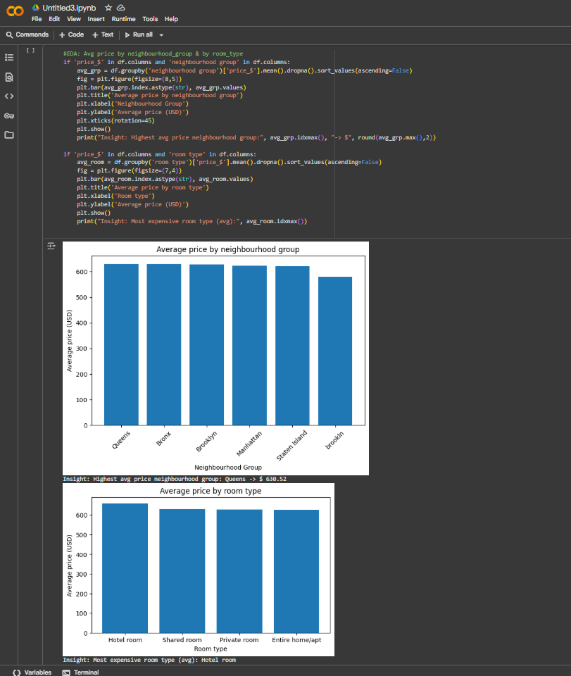
RESULTS2
Demo Link

Slide 8
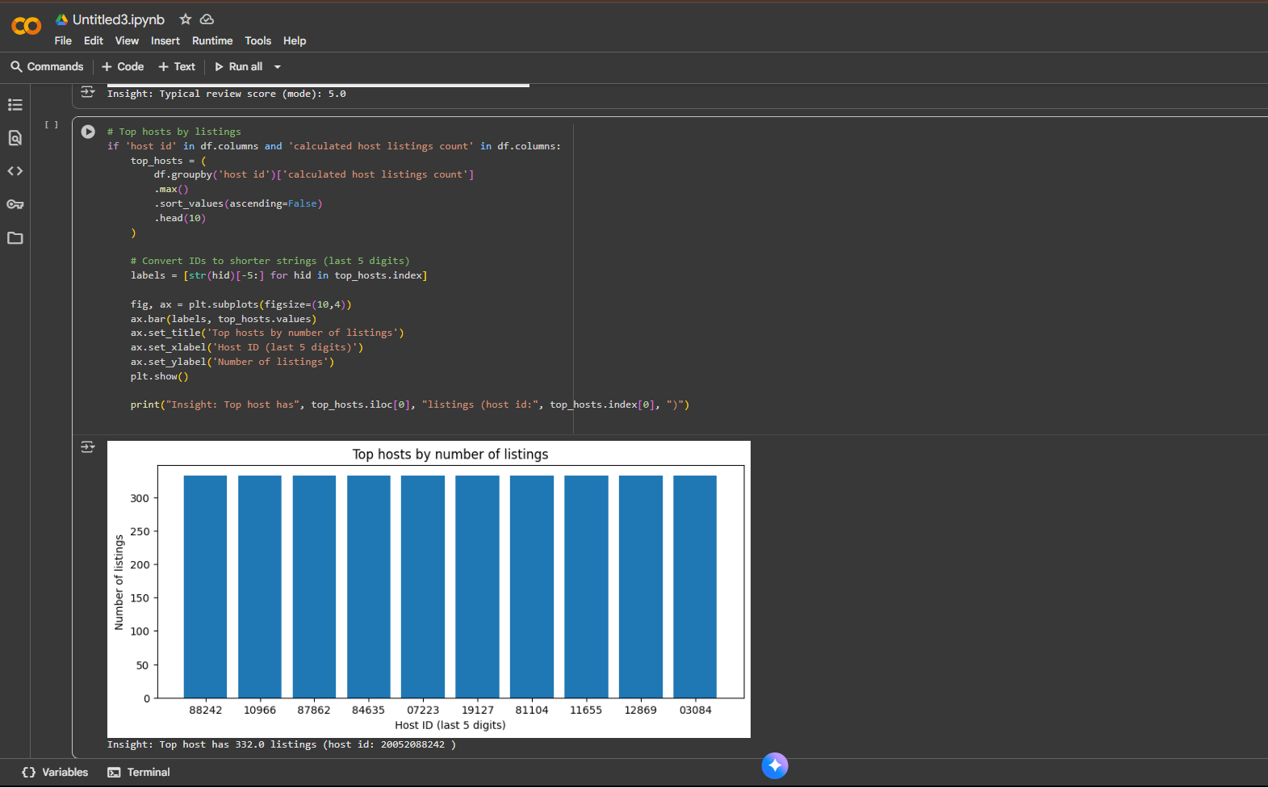
RESULTS3
[Add screen shots of your code or Chart(s) ]
Demo Link

Slide 9
GitHub repository
https://github.com/Divya1011-design/VOIS_AICTE_Oct2025_DivyaSharma.git
Demo Link

Slide 10
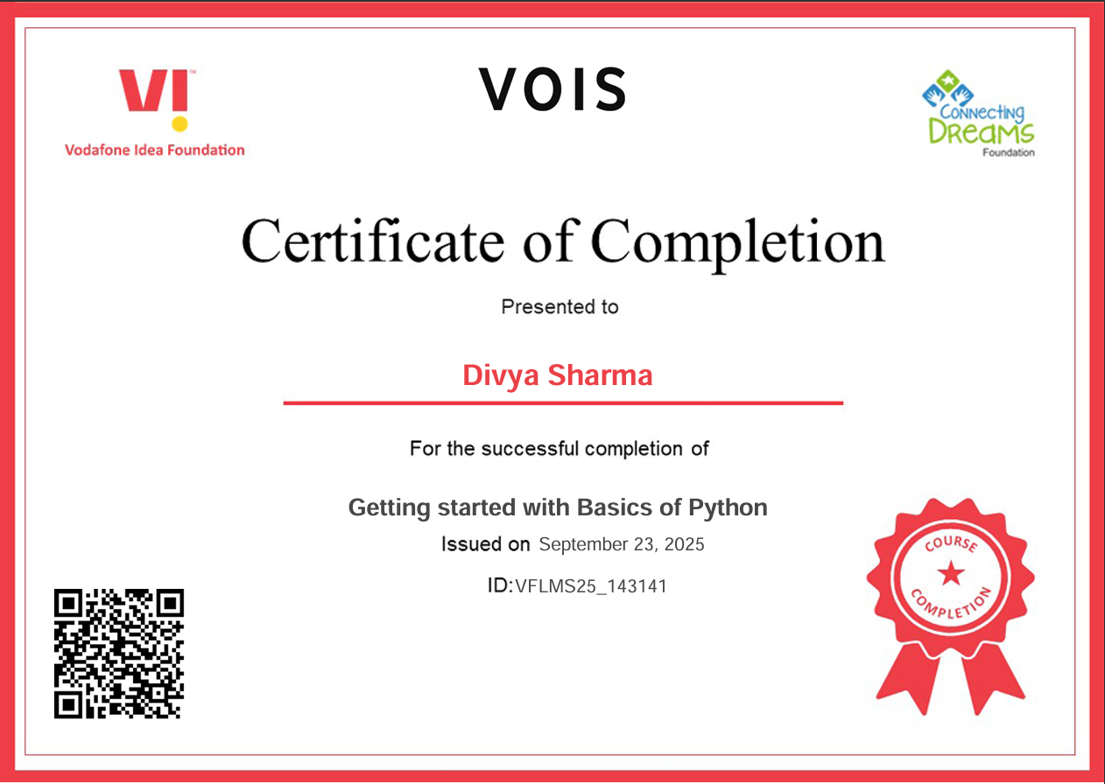
Getting started with Basics of Python Certificate

Slide 11
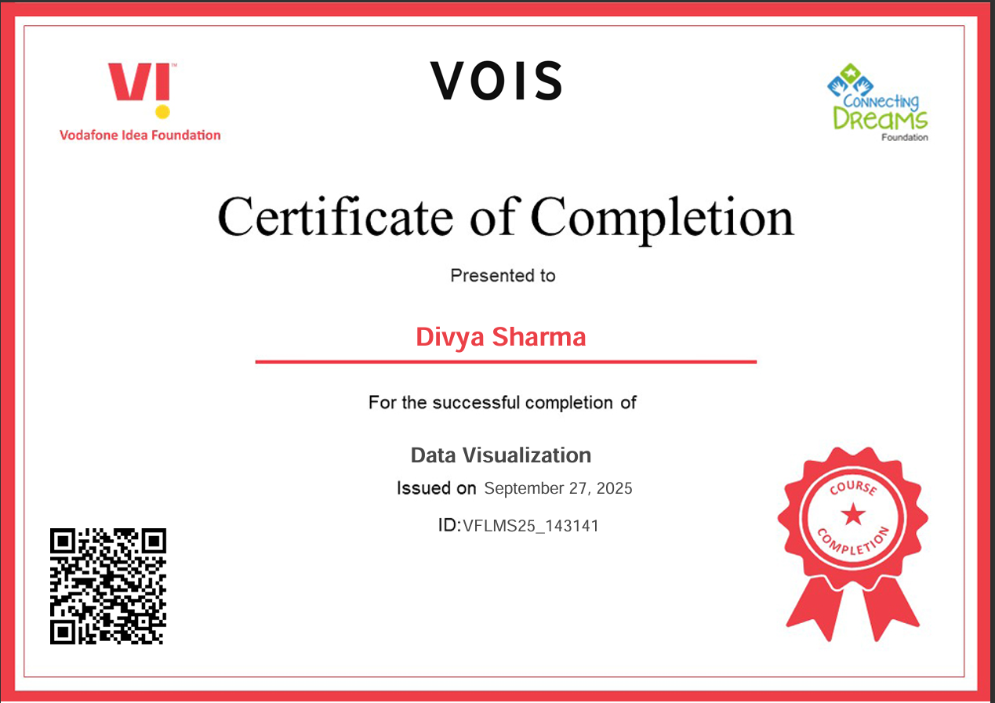
Data Visualization Certificate

Slide 12
Thank you
Lets Connect :
linkedin.com/in/divya-sharma-i
.
.

